Slide 1

An efficient Student Portal For College

Slide 2
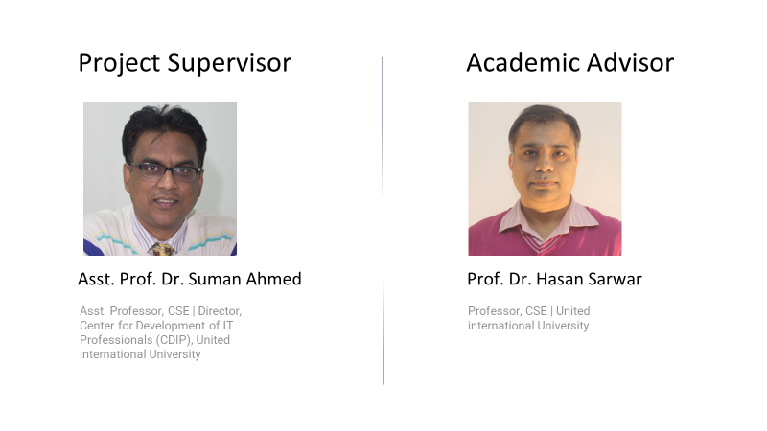

Slide 3
Group Members
Md Minhajul Arefin Fahim(011181233)
Sharmila Tabassum
(011183100)
Iftida Isaba (011183100)
Mahmudul Hasan (011191210)
Tanjim Chowdhury (011191157)

Slide 4
Outline
Introduction
Project overview
Motivation
Methodology
Background
Literature review
Benchmark analysis
Survey
Gap analysis
Project Design
Functional and nonfunctional requirement
Context Diagram
Data Flow Diagram
Ui Design
Project Plan
Complex Engineering
1. Technical challenges
2. Development challenge

Slide 5

Introduction
A digitalized electronics learning platform.
An interacting platform with a single point of access to information.
A platform for real time students’ progress monetizing.
Easy to use.

Slide 6
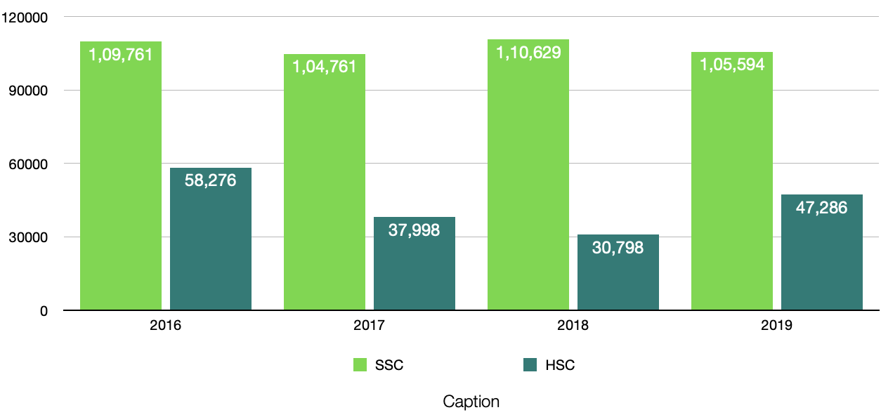
Why Every College Needs a Modern Student Portal?
SSC and HSC result difference
Source: The Daily Star

Slide 7
Why Every College Needs a Modern Student Portal?
Class skipping:
50 percent report skipping class at least once
16 percent have skipped school or class “many times”
21 percent have contemplated dropping out of college
The Imprint News
Drug addiction: At least 550,000 Bangladeshi students are addicted to drugs -Dhaka Tribune
Internet addiction: Among 60 million internet users in Bangladesh 35% are secondary and higher secondary students and approximately 50% of them struggling with moderate to severe internet addiction.- Dhaka Tribune

Slide 8
Motivation
To create e smooth interface for students.
Minimize teacher parent communication gap
Tracks all the information of students.
Easily tracks learner progress and performance.
Organizes eLearning content in one location.

Slide 9
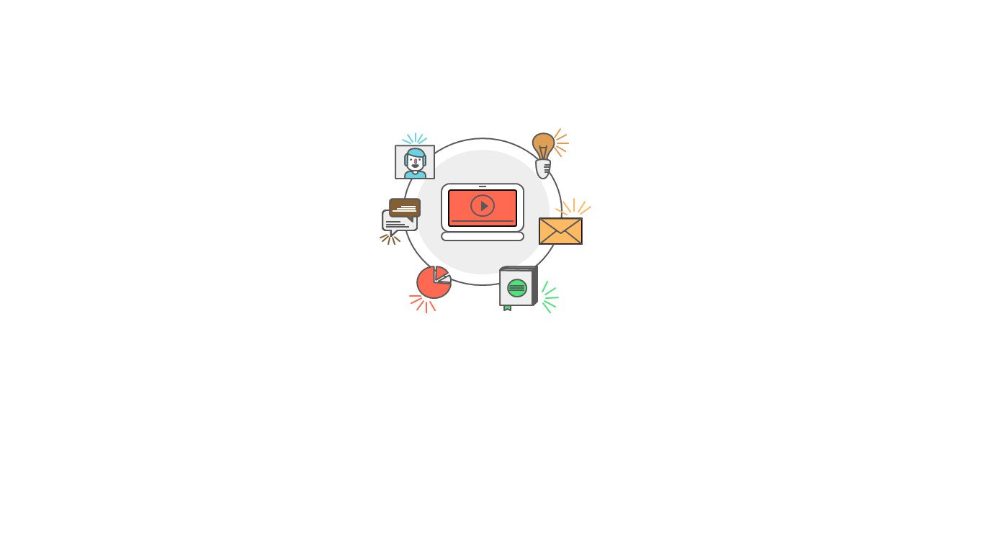
Vision
Vision statement:
The goal of the project is to successfully implement a online student portal for college.
To minimize the communication gap between teachers,students,guardians

Slide 10
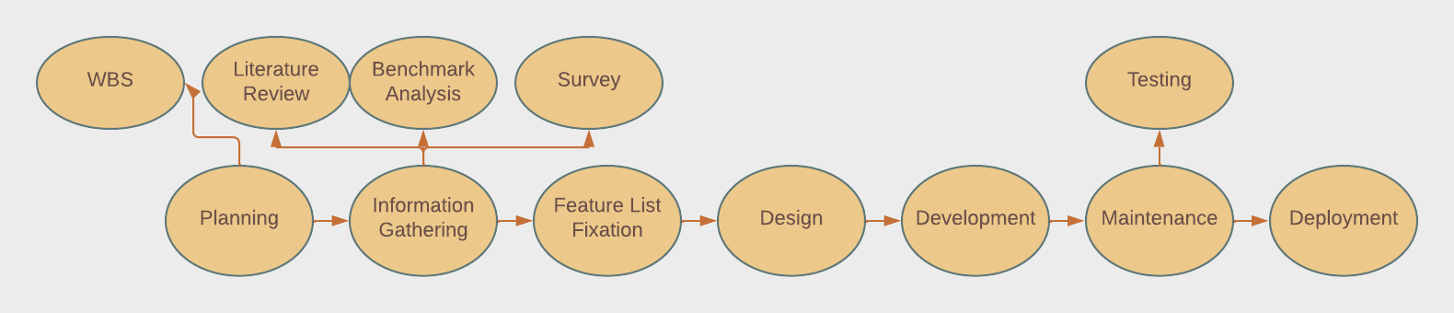
Project Methodology

Slide 11




Literature Review

Slide 12
LIterature Review on 5 Papers
Name of the paper | Description | Findings from paper | Limitation of the paper
“The Intention to Use Mobile Student Portal: A Mobile Human Computer Interaction Study in a University Context in Egypt” REF: author={El Said, Ghada Refaat}, journal={Mobile Information Systems}, volume={2018}, year={2018} | The authors have constructed a semi- structured interview with 52 students to take their opinions on student portal system they use &amp; what they wanted more in it. | 1. Priority tasks are labeled &amp; easy to spot 2. Option for sharing information, posting activities by themselves 3. Option for to share important event notices into their social medias 4. User control over features 5. Personalized notification system | As this is a Survey paper , it didn’t exclusively talked about any solutions rather focused on the needs if the students
” Current Situation of Students’ Portal and Their needs: A Case Study in Saudi Arabia Universities: Students Perspective” REF: author={SYED, SALEM SULIMAN T ALATAWI$^1$ NORRIS and FAHAD, ABDULLAH$^2$ SURAYA MISKON}, journal={International Journal}, year={2020} | An online survey method has been used to gather information and analysis the results. The teachers also along with the students also took part in the survey. | 1. E-library system inside the portal 2. Having a discussion forum 3. Individual profile system 4. Full online based system for admission &amp; registration process 5. Good design interface 6. Calendar with important dates highlights in it | Same as discussed above

Slide 13
Name of the paper | Description | Findings from paper | Limitation of the paper
” Considering User Satisfaction in Designing Web-Based Portals” REF: author={Zazelenchuk, Todd W and Boling, Elizabeth}, journal={Educause Quarterly}, volume={26}, year={2003} | In this paper conducted a study on user satisfaction on web based portal system. Their study had found some factors to keep in mind while designing a web based portal to achieve user satisfaction. | 1. Efficiency of use 2. Clear &amp; helpful instruction 3. Giving feedback 4. Avoiding confusing terminology 5. Attractive interface | In here, the authors didn’t specify any specific problems about student portal. Nor it has the any solutions. It only focused on user satisfactions on a web based portals in general
“The success of Learning Management System among distance learners in Malaysian universities” REF: author={Almarashdeh, Ibrahim Abood and Sahari, Noraidah and Zin, Nor Azan Mat and Alsmadi, Mutasem}, journal={Journal of Theoretical \& Applied Information Technology}, volume={21}, number={2}, year={2010} | The authors focused on findings why many students, faculties don’t use student portal (LMS) system. | 1. Lack of interactive features 2. Finding slideshare, facebook, Youtube etc social sites easy to use then LMS 3. Lack of useful facilities 4. Finding hard to use then other platforms 5. Using other e-learning tools | The authors were focused on finding the reasons and finally advised that the concerned individuals to be more attentive on to find user satisfaction &amp; collecting data to design more easy to use &amp; useful LMS that users will be willing to use.
“Influence of faculty-and web portal design-related factors on web portal usability: A hierarchical regression analysis” REF: author={Bringula, Rex P}, journal={Computers \& Education}, year={2013}, | One of the major challenge is to build a student portal which is updated regularly with the latest information and also is ready to adapt to the increasing services, the authors explained. | 1. Students are not notified immediately after something is posted on the portal. 2. Not updated regularly. | Automatic E-mail or notification system after a new post has been shared to concern people.

Slide 14
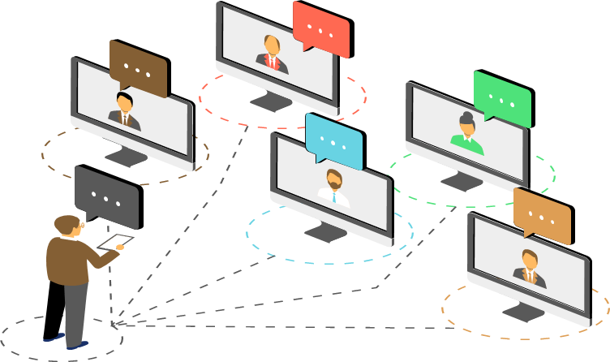
Benchmark Analysis

Slide 15
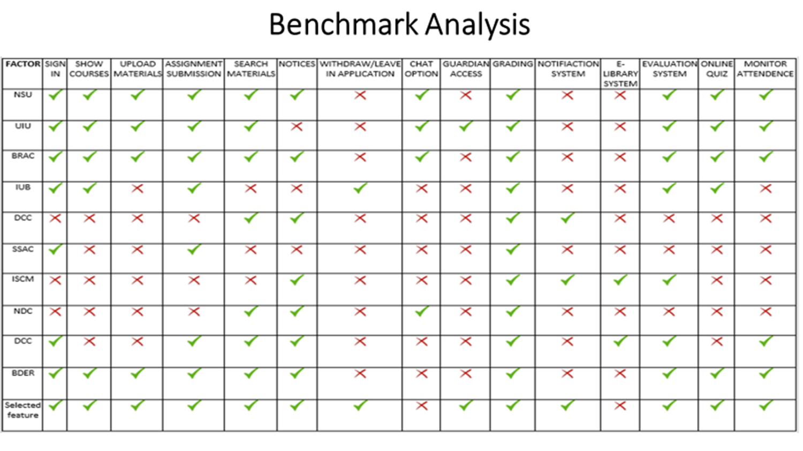

Slide 16
Survey on 20 College Students-
On their Views on Student Portal

Slide 17
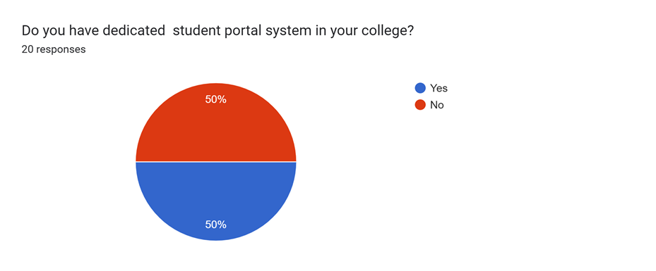
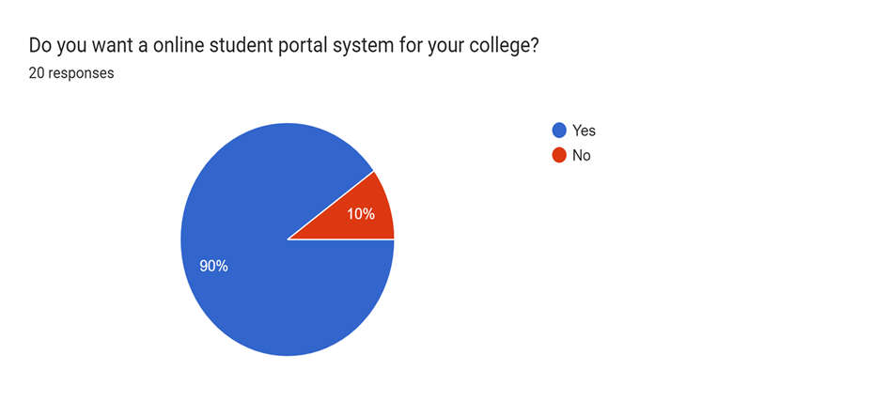
Discussion: 50% students don’t have student portal in their college. So, we will make a platform for those 50% students
Discussion: The findings showed that the majority of students (90%) preferred student portal for their college to enhance their study

Slide 18
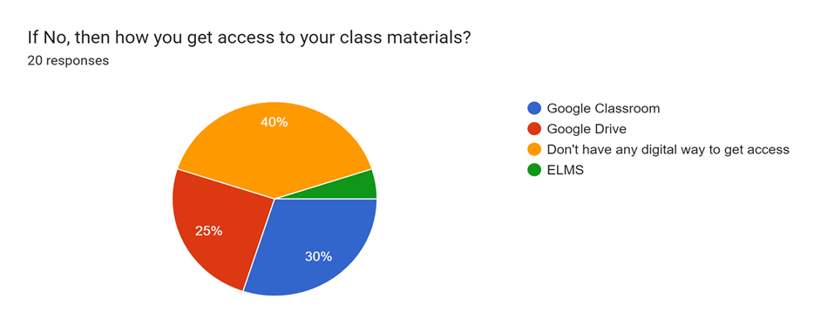
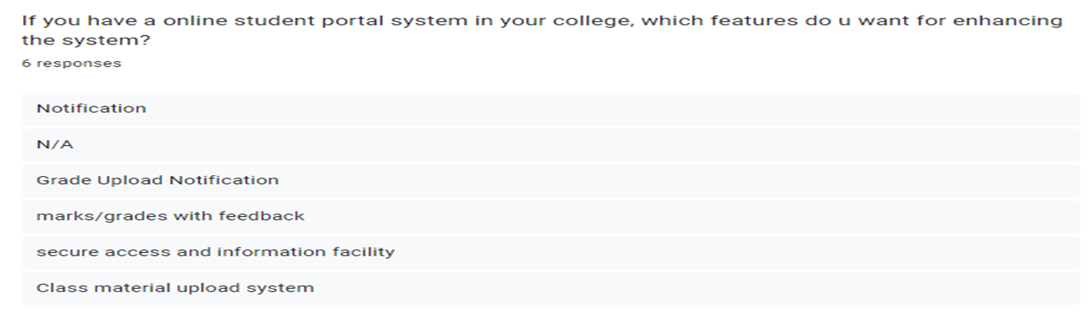
Discussion: 40% student don’t have any digital way to get access their class materials which inspire us to build a digital platform for them

Slide 19
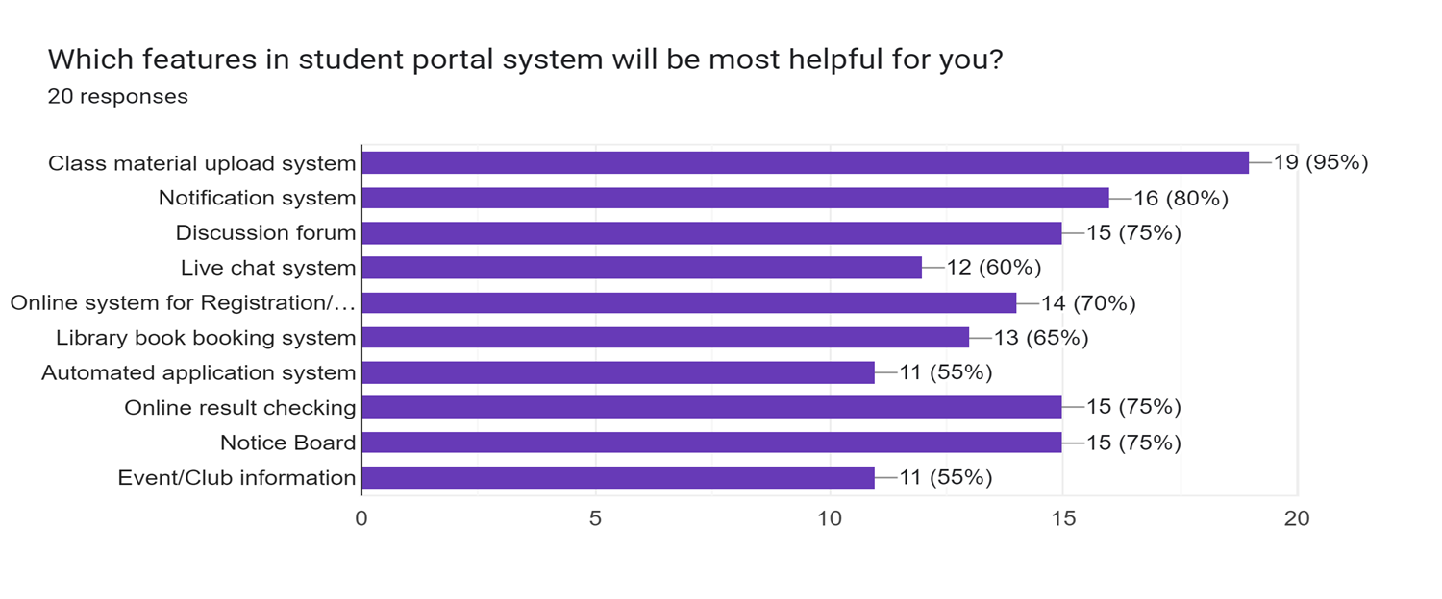
Discussion: Participants were asked about the kind of features they thought the portal should provide. They were given a number of options to choose from. Also they were allowed to choose multiple options. This chart shows the students responses.
All the features got more than 50% preference.

Slide 20
Survey on 20 College Students Guardians-
on their view on Student Portal

Slide 21
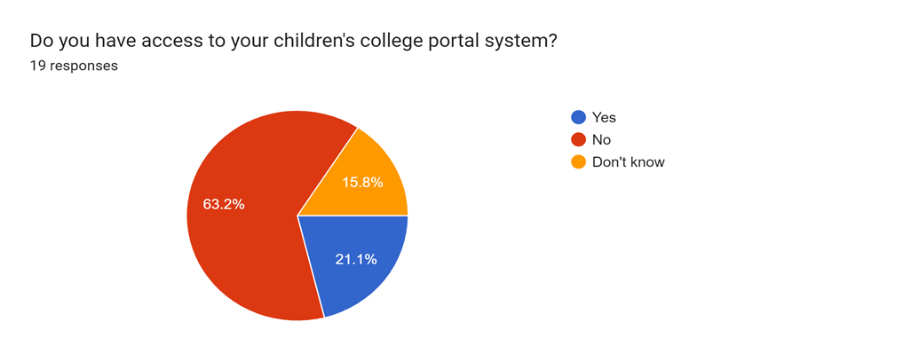
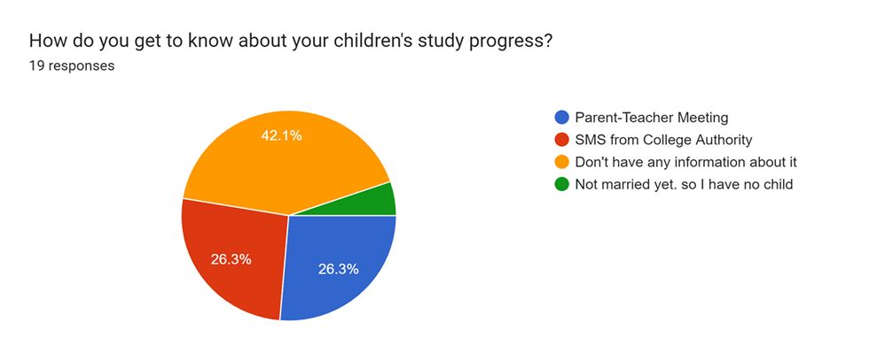
Discussion: The findings showed that the majority of guardians (63.2%) don’t have access. So we will make a platform where guardians can access the portal so that they can track their children progress.
Discussion: 42% guardians have no acknowledgement about their children’s progress in college that’s why we want to make guardians as a stakeholder of our student portal system so that they get to know their children’s study process.

Slide 22
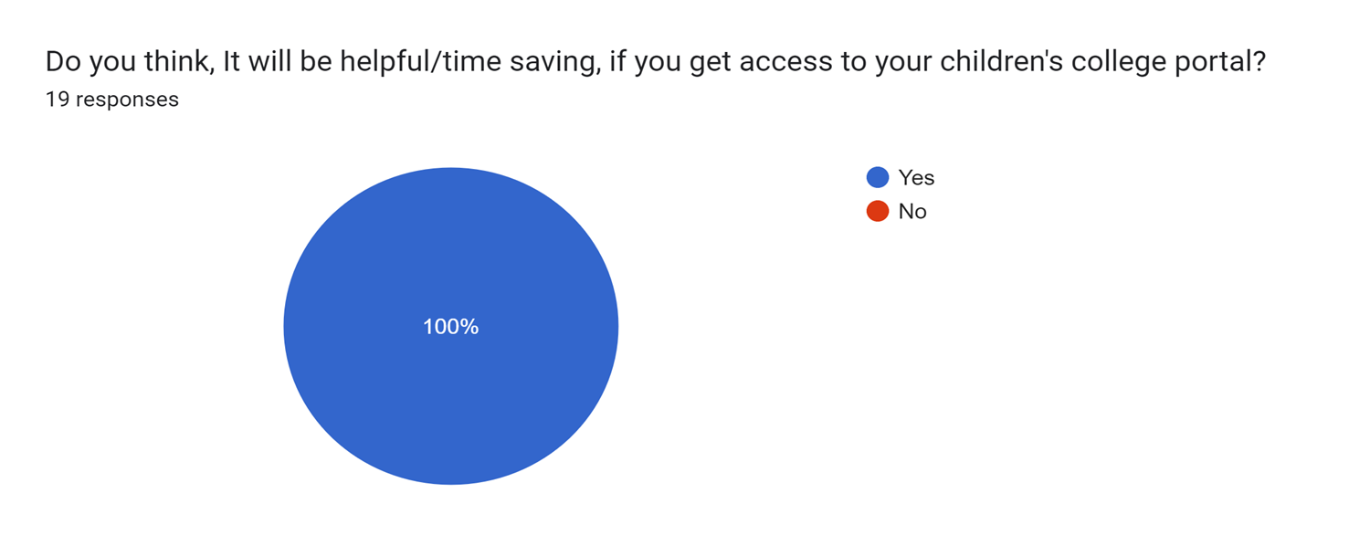
Discussion: This high percentage is not surprising since the colleges does not have a proper platform where students or guardians can use. This portal definitely minimize the communication gap between teachers and guardians.

Slide 23
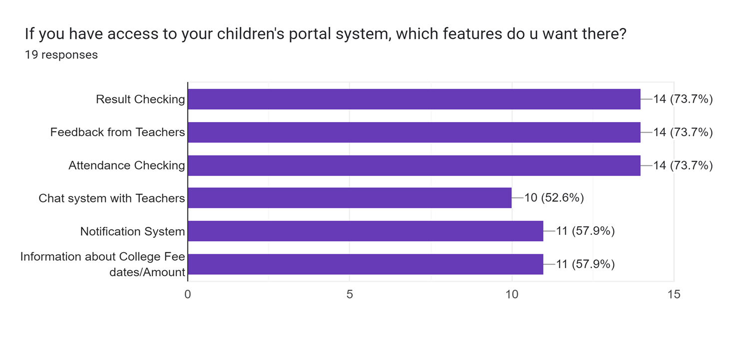
Discussion: Participants were asked about the kind of features they thought the portal should provide. They were given a number of options to choose from. Also they were allowed to choose multiple options. This chart shows the guardian responses.

Slide 24
Gap Analysis
None of the portal have the guardian access.
Majority portal don’t have online leave application system.
Majority portal don’t have notification
system as well.

Slide 25
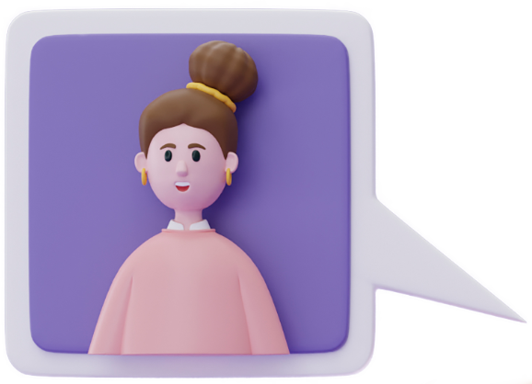
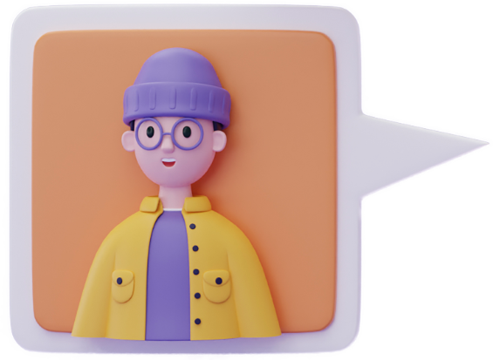
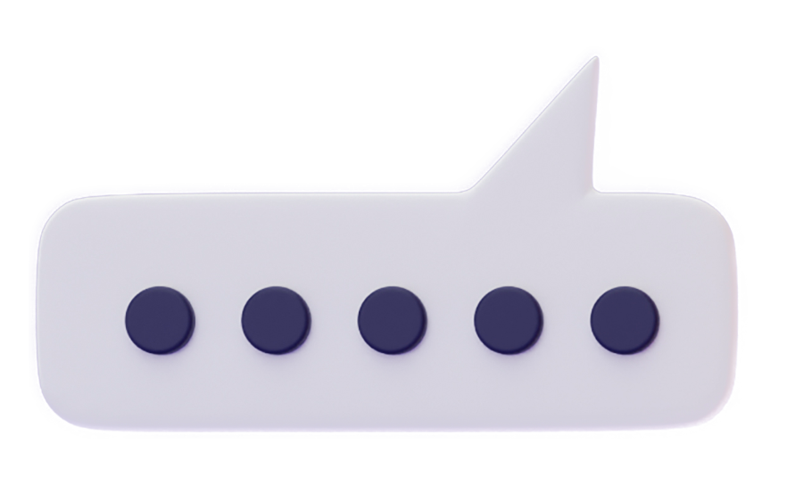

Requirements Analysis

Slide 26



Functional Requirements
User Authentication
Network Access
Notice
Leave in Application
Guardian Access

Slide 27
Non-Functional Requirements
Usability requirements
Availability requirement
Efficiency requirement
Performance requirement

Slide 28
Stakeholder-wise features fixation
Student
Teacher
Guardian
Login/Signup
Show course materials
Upload course materials
Search course materials
Online grading system
Notification system
Evaluation system
Login/Signup
Notification system
Monitor attendance, result and notify guardians.
Track result and show them in one place
Feedback to guardian from teacher about students exam performance.
Login/Signup
Notification system
Track children progresses.
Get Feedback

Slide 29
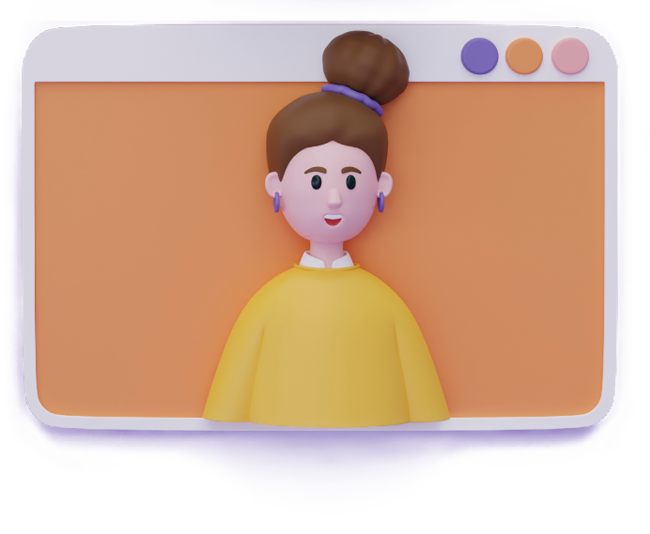

UML Diagrams

Slide 30
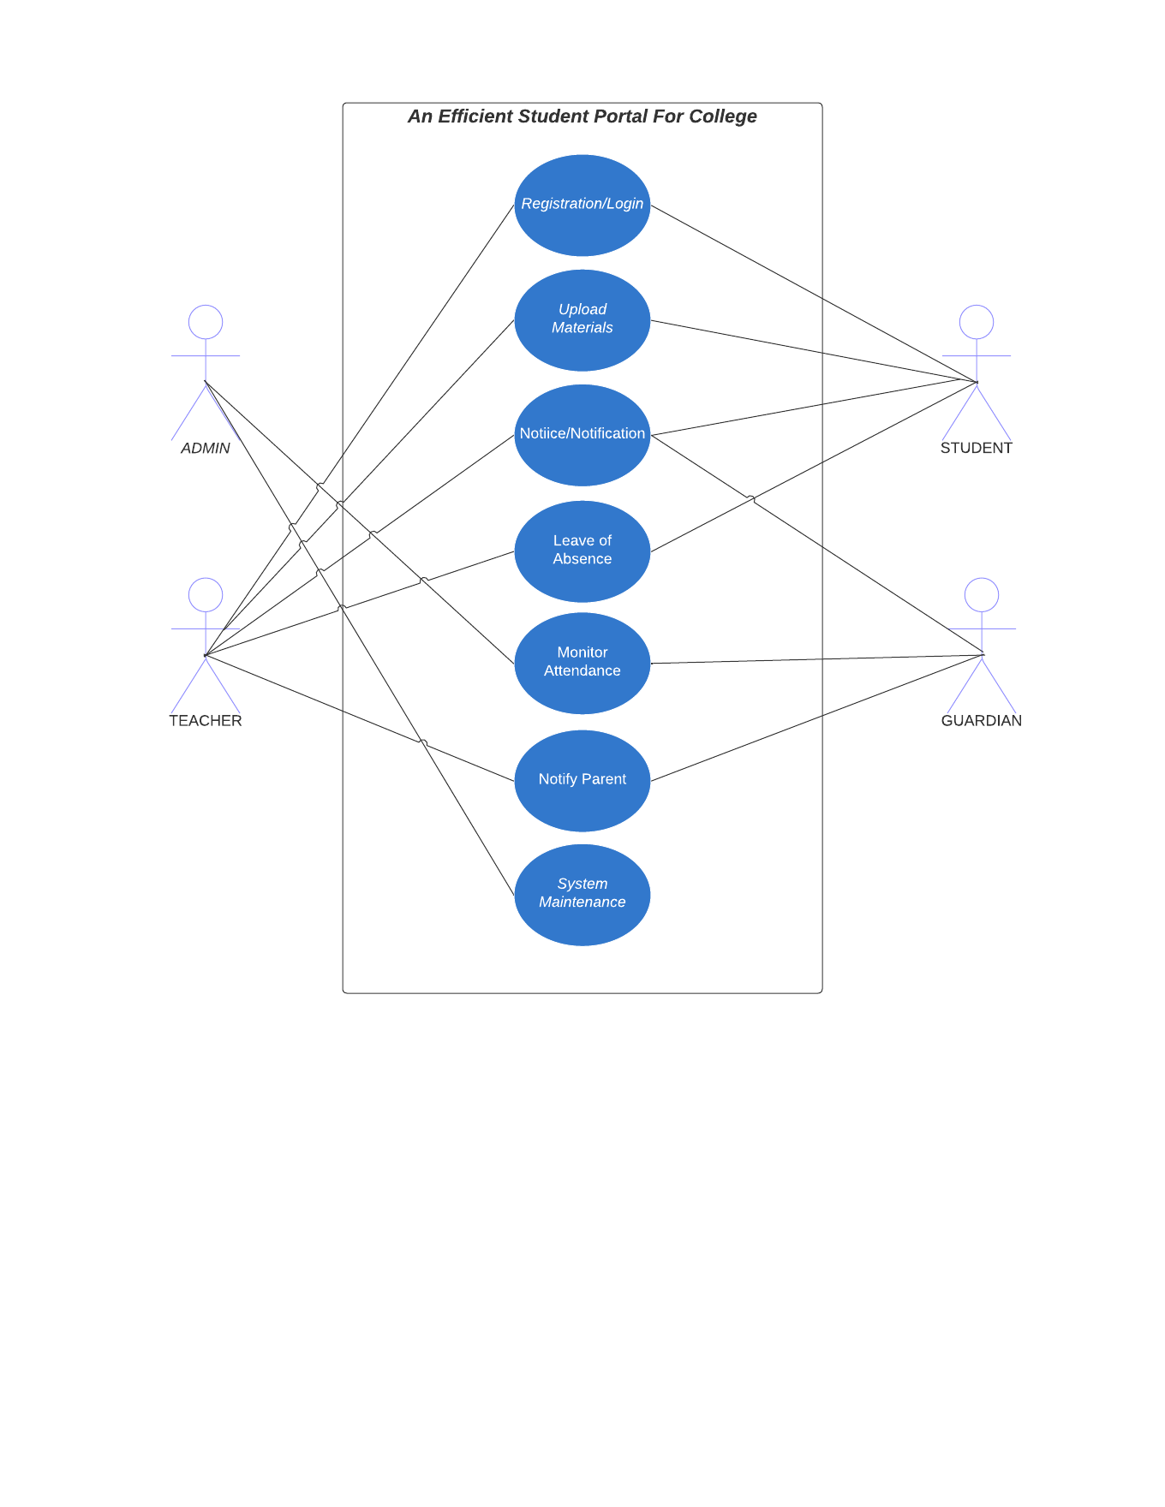
Use Case Diagram

Slide 31
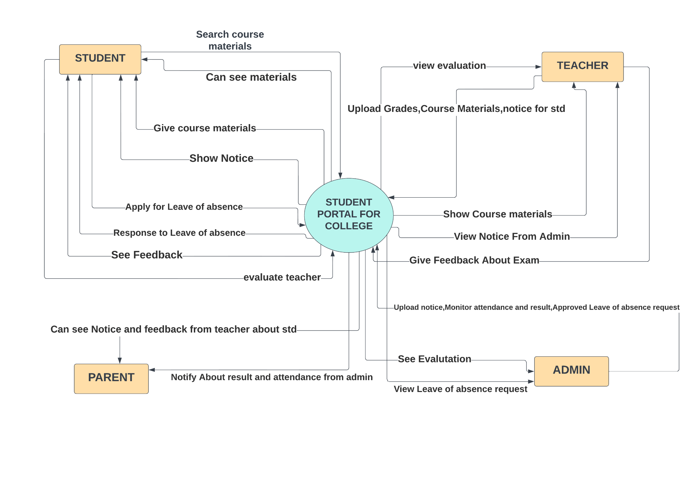
Context Diagram

Slide 32
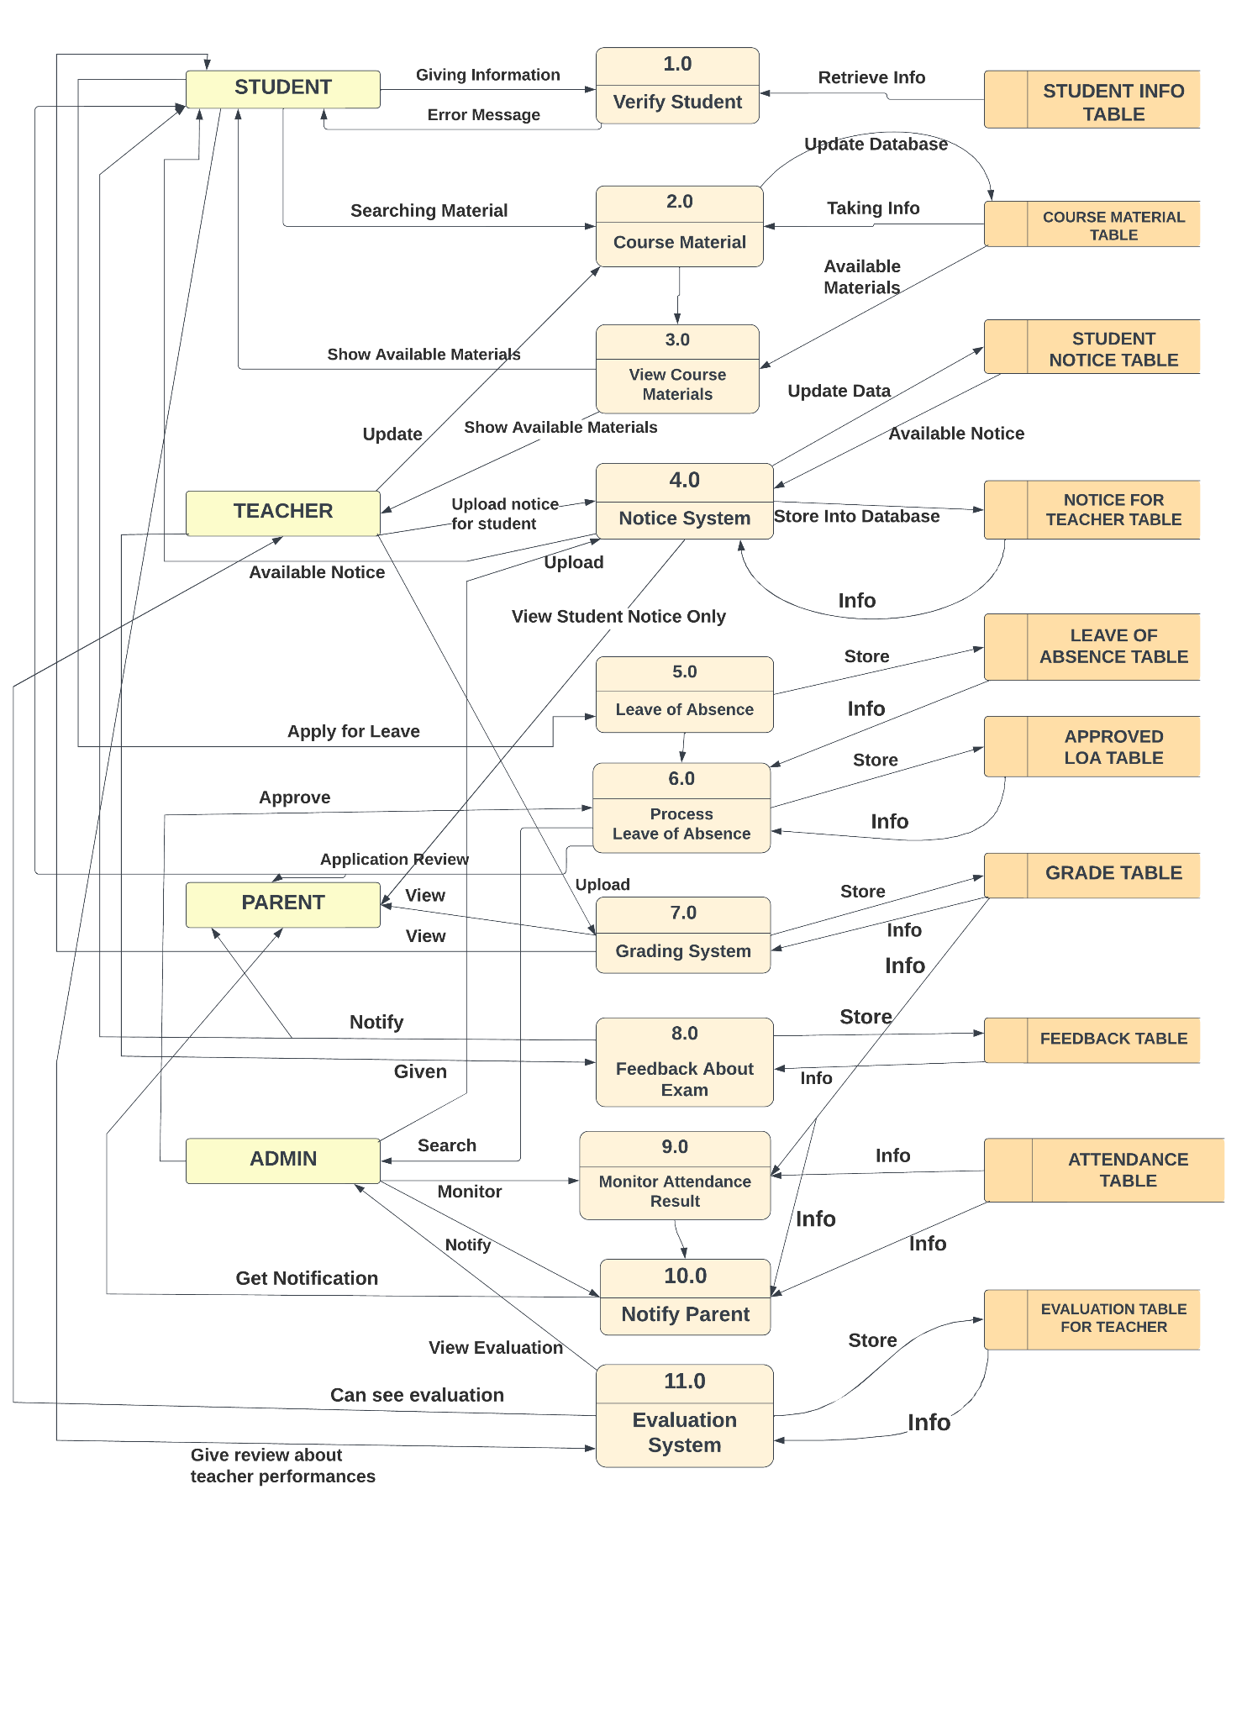
Data Flow diagram

Slide 33
Ui Design

Slide 34
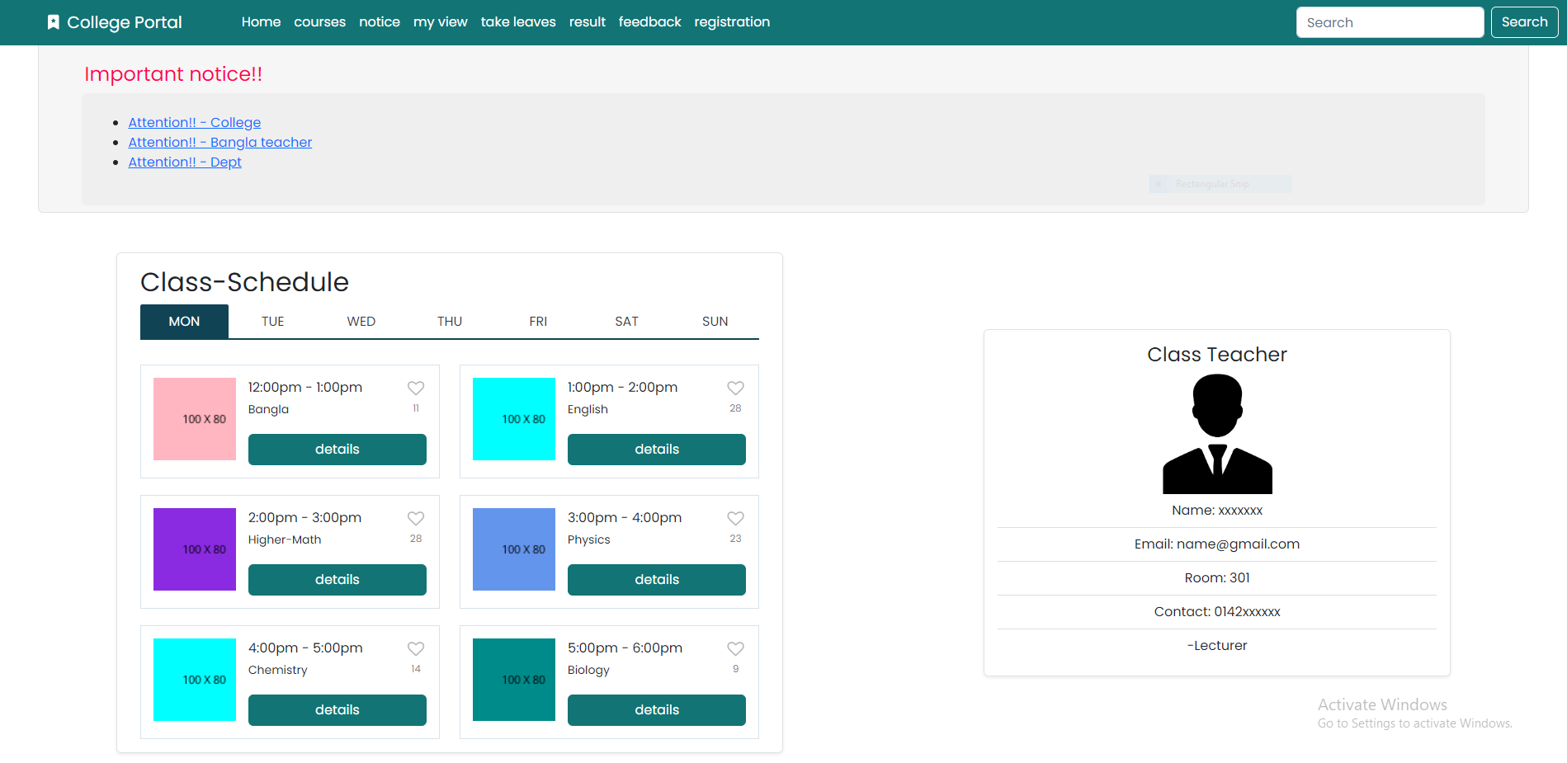

Slide 35
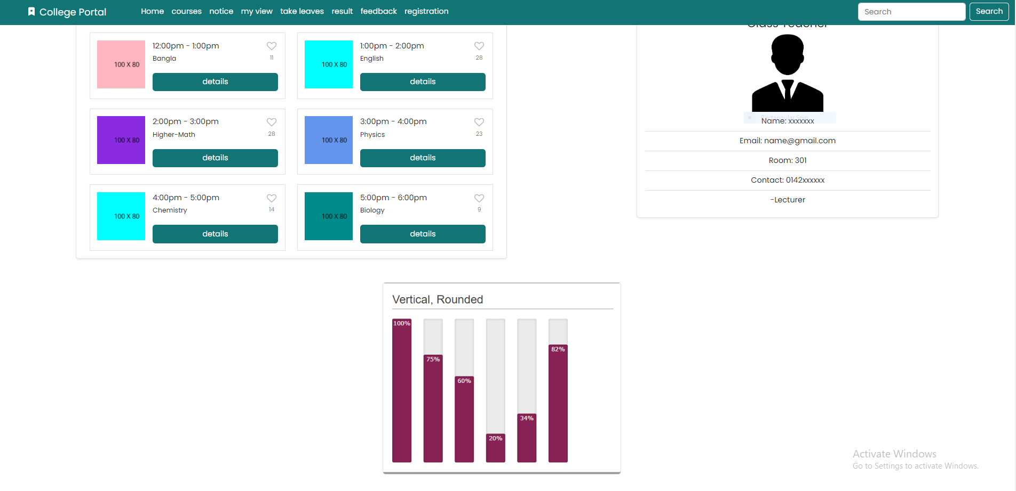

Slide 36
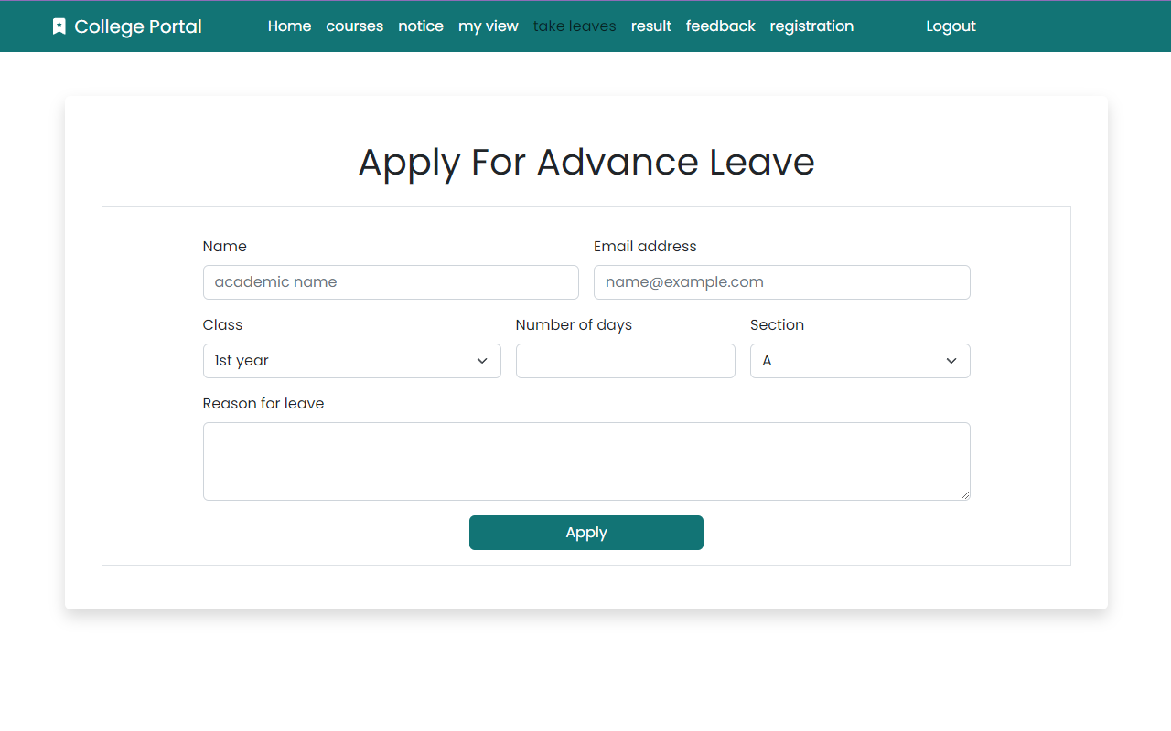

Slide 37
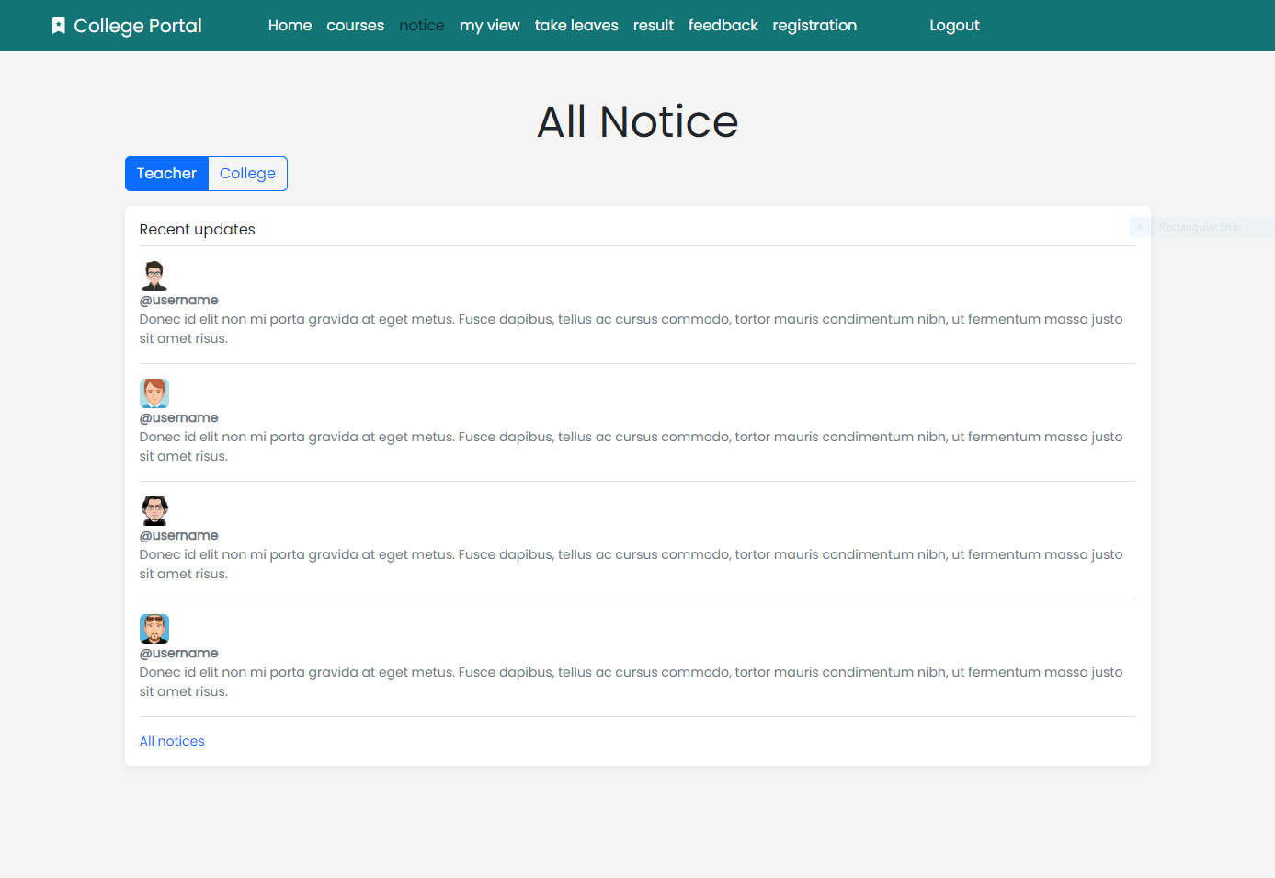

Slide 38
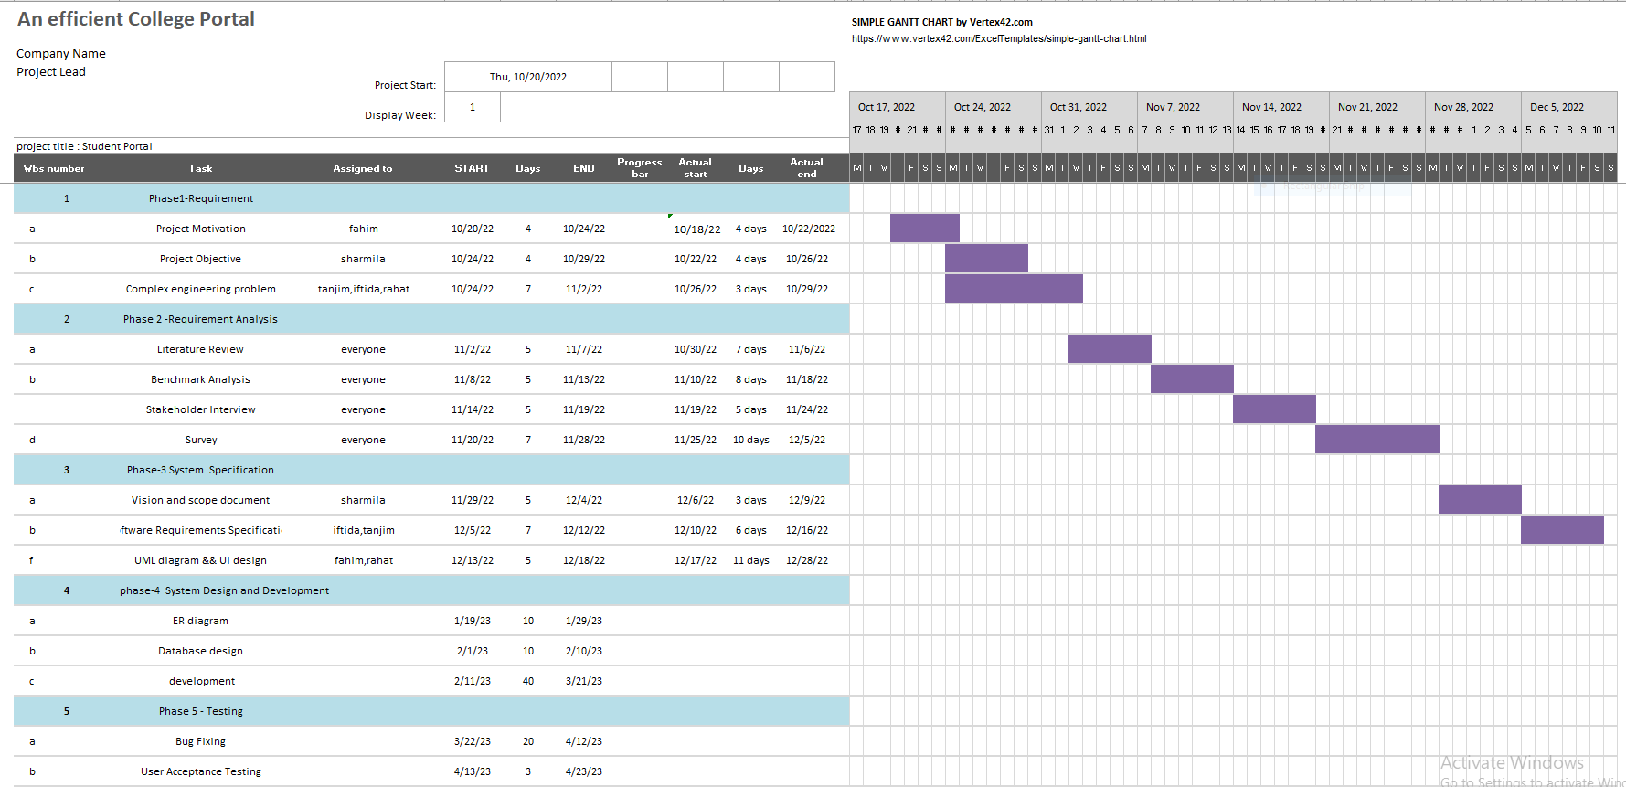
WBS-Gantt Chart

Slide 39

How Complex Engineering mapped with our project
Depth of knowledge required | Range of conflicting requirements | Depth of analysis required | Familiarity of issues | Extent of applicable codes | Extent of stakeholder involvement and needs | Inter dependence

Slide 40


Depth of Knowledge Required
Bootstrap, Tailwind
React.js
Node.js
Database (MongoDB)
MVC architecture
Data structure and algorithm

Slide 41
Depth of Knowledge Required
Identify particular NPM
More than 8,00,000 packages
Vulnerability Check for security
Using npm audit package
Using Retire.js , NODEJSSCAN tools
Nodejs lacks of stable API
Technical Dept
No specific guideline to build App
Find out individual approach
Scalability challenges
Single threaded process
Follow Microservice Architecture
Poor documentation

Slide 42
Extent of stakeholder involvement and needs
Depth of Analysis Required
Interdependence
Literature review
Benchmark analysis
Gap analysis
Student
Teacher
Guardian
Git / GitHub
Jira

Slide 43
